Slide 1
K J Somaiya College of Engineering, Mumbai-77
Twitter Sentiment Analysis
Submitted in partial fulfillment of requirements
For the degree of
Bachelors of Technology
(Semester-8)
Presented by:
Jaini Gala
Roll No: 1713026
Fenil Madlani
Roll No: 1713035
Guide
Ms. JAYSHREE M. KUNDARGI

Slide 2
Overview of Presentation
Results
Analysis of Results
Conclusion
Future Scope
References
Problem Statement
Abstract
Introduction
Literature survey
Methodology

Slide 3
Problem Statement
There is an increasing need to understand the opinions and suggestions of the citizens in regards to the policies implemented by their respective government to understand how well they have been accepted. Twitter, is a platform which the users can use to voice their opinions on topics of importance.
Our aim of this project is to build a program to perform Twitter Sentiment Analysis using machine learning algorithms and which filters the tweets based on the subject and location, classify them and provide us a general analysis of what the people are feeling about the USA 2020 Elections.

Slide 4
Introduction
Sentiment analysis is the analysis of feelings in text, videos or images. Accurately, it may be a opinion of public.
Individuals connect with other individuals and to remain well aware with news and current occasions. Social media has become a stage to individuals to voice their suppositions. Of all social media twitter is platform were most users share their opinion on current affairs.
Emotion on social media have its wide effect on various industries. Twitter Sentiment Analysis is used in industries for:
• Improving Customer Experience (CX) and digital marketing.
• Monitor various sentiments in real-time and over-time.
• Identifying fake news and automatically blocking/reporting them.

Slide 5
Continued...
Understanding people’s emotions is essential since users are able to express their thoughts and feelings more openly than ever before. By analyzing tweets various predictions can be made.
In this project we have classified tweets from twitter into ‘positive’ or ‘negative’ sentiment by building different machine learning model to understand the emotions of people towards ‘Donald Trump’ and ‘Joe Biden’ for US Elections 2020.

Slide 6
Literature Survey
“Twitter as a Corpus for Sentiment Analysis and Opinion Mining” by A Pak and P. Paaroubek, In Proceedings of the Seventh Conference on International Language Resources and Evaluation, 2010.
Created Twitter Corpus using Twitter Api to gather data.
Naive Bayes Classifier along with features like Ngram, POs was used to classify tweets.
Model did not achieve better accuracy as the trained data contained tweets that only includes emojis

Slide 7
Literature Survey
”Opinion Mining on Social Media Data” by Po-Wei Liang, Bi-Ru Dai, IEEE 14th International Conference on Mobile Data Management Milan, Italy, June 3-6, 2013, ISBN:978-494673-6068-5.
Real life data was extracted from twitter in the form of hashtags.
Preprocessing of data was done using Stemming and Tokenization.
Naive Bayes Classifier was used to classify sentiments
Visualization was done using histogram and pie charts.

Slide 8
Literature Survey
”Comparison Research on Text Pre Processing Methods on Twitter Sentiment Analysis” by Zhao Jianqiang and Gui Xiaolin, In IEEE Research Journal., 22 February 2017, DOI: 1109/ACCESS.2017.2672677.
Preprocessing methods- Replacing negative mentions, Removing URL links in the corpus, Reverting words that contain repeated letters to their original English form, Removing numbers, Removing stop words, Expanding acronyms to their original words by using an acronym dictionary
ML algorithms like SVM, Naive Bayes, Logistic Regression, Random Forest were used to classify tweets.
Precision and F1 score was improved with preprocessing techniques
Naive Bayes and Random Forest classifier are sensitive to preprocessing techniques.

Slide 9
Literature Survey
USA Nov.2020 Election. Tweets (with Sentiment and Party Name Labels) Dataset by Ibrahim sabuncu- Kaggle
Only classification of tweets into positive and negative sentiments was done by him.
Classification was done using Vader Algorithm, textblob and nltk.
We have used different Machine Algorithms like Decision Tree, Logistic Regression, Random Forest, K Nearest Neighbour to classify tweets into positive and negative.

Slide 10
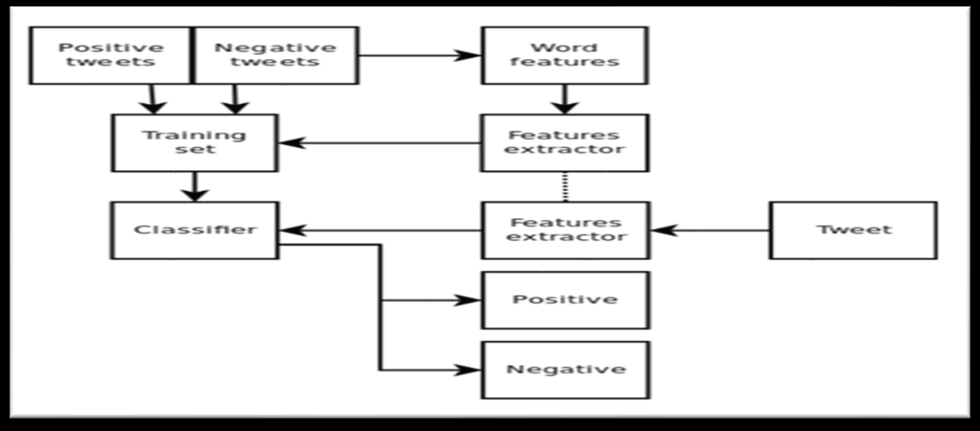
Proposed Method
The training dataset which comprises of positive and negative tweets on USA 2020 elections.
After reading the data, the parameters that were not required were eliminated.
In the feature extractor data was preprocessed so that the accuracy of learning algorithm can be improved and time duration can be shortened.
Then the training data was divided into train dataset and validation dataset, after which it was passed to classifier.
Based on results, we selected an appropriate classifier.
In a similar manner, test data was passed through classifier and then analysis of results was done.

Slide 11
Dataset Description
Train Data:
We have used US Election Tweets Sentiment Dataset as our training dataset. It consists of 109901 rows and 4 columns. The columns include:
Id - Unique for every tweet
Tweet - Includes tweets on USA 2020 Elections
Label - Consists integer values 0 and 1. 0 for positive tweet and 1 for negative tweet
Candidate Hashtag - Includes candidate name ; It is either Joe Biden or Donald Trump

Slide 12
Continued….
Test Data:
Test data is collection from Twitter using the twitter API. Utilizing Tweepy library, we gathered the Twitter data. The OAuth is gave the keys. Consumer Key, Consumer Secret, Access Token, and Access Token Secret for twitter application.
The test data consists of 9637 rows and four columns. The columns are :
Id - Unique for every tweet
Tweet - Includes tweets on USA 2020 Elections
State - It is the US state from where the tweet was tweeted
Subject - It is the subject of the tweet (either Donald Trump or Joe Biden)

Slide 13
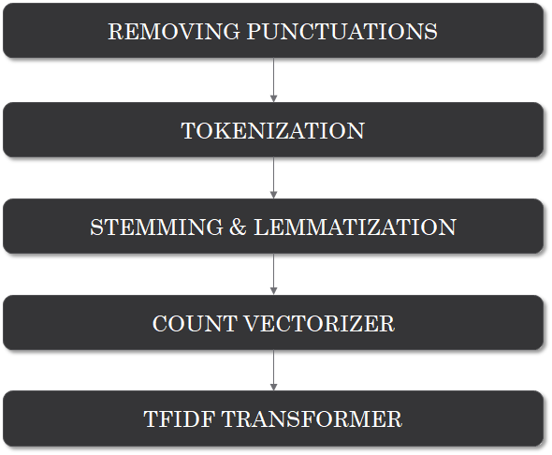
Data Preprocessing

Slide 14
Classification Models Used
Decision Tree
K Nearest Neighbour
Random Forest
Logistic Regression
Metrics Used to Evaluate Model Performance:
Accuracy - Accuracy is the most intuitive performance measure and it is simply a ratio of correctly predicted observation to the total observations.
Precision - Precision is the ratio of correctly predicted positive observations to the total predicted positive observations.
Recall (Sensitivity) - Recall is the ratio of correctly predicted positive observations to the all observations in actual class.
F1 score - F1 Score is the weighted average of Precision and Recall.

Slide 15
Decision Tree
Decision tree is the most powerful and popular tool for classification and prediction. A Decision tree is a flowchart like tree structure, where each internal node denotes a test on an attribute, each branch represents an outcome of the test, and each leaf node holds a class label.
Advantages
Less effort for data preparation
Normalization not required
Missing values in the data does not affect.
Very intuitive and easy to explain
Disadvantages
Small change in data cause a large change
Involves higher time to train data
Training is expensive (Complexity)
Inadequate for predicting continuous value
‹#›

Slide 16
K Nearest Neighbour
K-NN algorithm stores all the available data and classifies a new data point based on the similarity. This means when new data appears then it can be easily classified into a well suite category by using K- NN algorithm. K-NN algorithm can be used for Regression as well as for Classification but mostly it is used for the Classification problems. K-NN is a non-parametric algorithm, which means it does not make any assumption on underlying data.
Advantages
No training period
New data does not affect
Easy to implement
Less parameters are required
Disadvantages
Does not work well with large datasets
Does not work well with large dimensions
Need feature scaling
Sensitive to noisy data, missing values and outliers
‹#›

Slide 17
Random Forest
Random Forest can be used for both Classification and Regression problems in ML. It is based on the concept of ensemble learning, which is a process of combining multiple classifiers to solve a complex problem and to improve the performance of the model.Instead of relying on one decision tree, the random forest takes the prediction from each tree and based on the majority votes of predictions, and it predicts the final output.
Advantages
Less prone to overfitting
Outputs importance of features
Flexible to classification and regression
No normalization required
Disadvantages
Much computational power and resources
Much time for training
May change considerably by small change in data
Computation is far more complex than other algorithms

Slide 18
Logistic Regression
Logistic Regression is a predictive algorithm using independent variables to predict the dependent variable, just like Linear Regression, but with a difference that the dependent variable should be categorical variable.It is a statistical model that uses Logistic function to model the conditional probability.
Advantages
Easy to implement, interpret and efficient to train
Very fast at classifying outputs
Less inclined to overfitting
Good accuracy for simple data
Disadvantages
Overfit in high dimensional datasets
Does not work well for nonlinear separable dataset
Tough to obtain complex relationship
Only used to predict discrete function

Slide 19
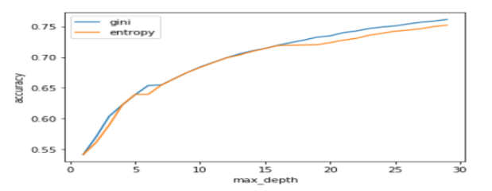
Outcome of Each Model
Decision Tree Classifier
Default Parameters:
Accuracy = 0.82
Train Accuracy = 1.00
Test Accuracy = 0.828
After Hyperparameters Tuning:
Criterion_gini = 0.81
Criterion_entropy = 0.83
Train Accuracy = 0.988
Test Accuracy = 0.837
Accuracy = 0.837
Confusion Matrix
[[9316 1602]
[2000 9063]]

Slide 20
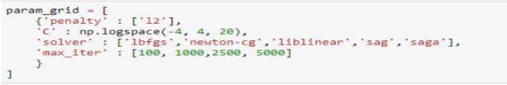
2.Logistic Regression
Default Parameters:
Accuracy = 0.908
After Hyperparameters Tuning:
Test Accuracy = 0.91
Accuracy = 0.913
Confusion Matrix
[[9923 995]
[1021 10042]]

Slide 21
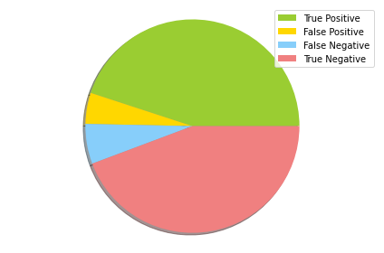
3.Random Forest Classifier
Default Parameters:
Test Accuracy = 0.8857
After Hyperparameters Tuning:
Train Accuracy = 0.904
Test Accuracy = 0.893
Accuracy = 0.893
Confusion Matrix
[[9882 1036]
[1331 9732]]

Slide 22
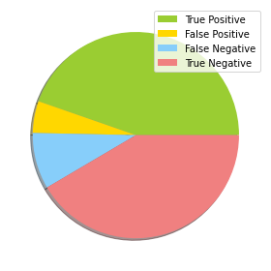
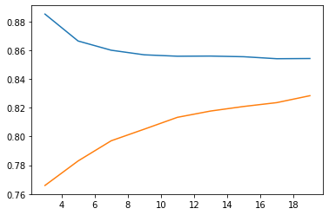
4. K Nearest Neighbour Classifier
Default Parameters:
Test Accuracy = 0.76
After Finding Optimal K Value :
Accuracy = 0.862
recall = 0.835
precision = 0.89
F1_score = 0.86
Confusion Matrix
[[9819 1099]
[1934 9129]]

Slide 23
Results
Parameters | Decision Tree | K Nearest Neighbour | Random Forest | Logistic Regression
Accuracy | 83.7 | 86.2 | 89.16 | 91.3
Precision | 85.3 | 89.93 | 90.1 | 91.2
F1 | 83.7 | 86.62 | 89.28 | 90.9
Recall | 82.3 | 83.54 | 88.45 | 90.7

Slide 24
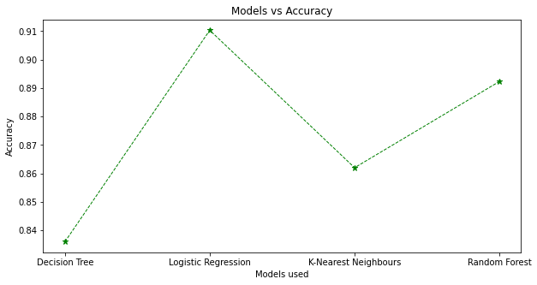
Comparison of all four Models used

Slide 25
Analysis of Results
For this we separate out tweets of two candidates (Donald Trump and Joe Biden) into two data frames.
Then we determine number of tweets of each candidate for each an every state. The output for the same is shown below.

Slide 26
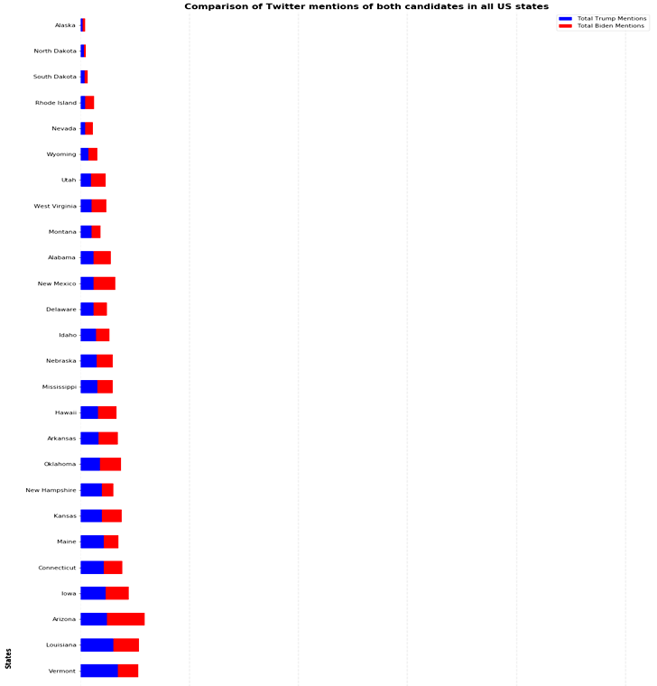

Slide 27
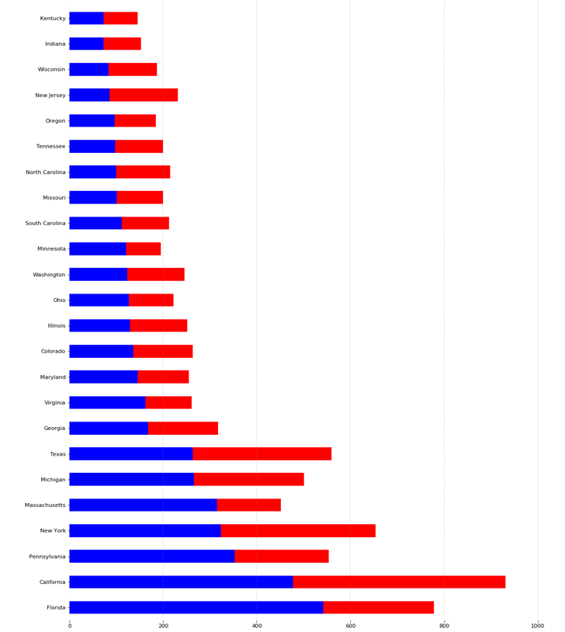

Slide 28
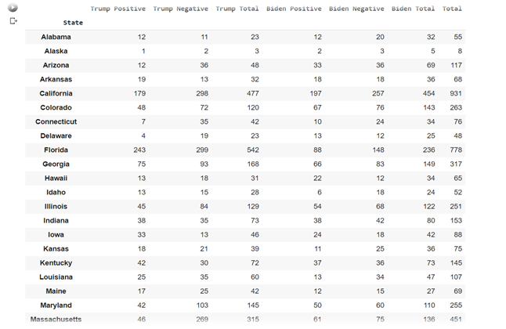
Number of positive and negative tweets statewise for each candidate

Slide 29
Prediction for each State
In a particular state if the number of positive tweets for a candidate surpasses the same for other candidate and the number of negative tweets are also less than other the candidate is strongly leading in that state.
If the margin between positive tweets is more than the margin for negative tweets then there is mixed public opinion for both candidate for the particular state.
For state where there are less than 15 tweets then the data is insufficient.

Slide 30
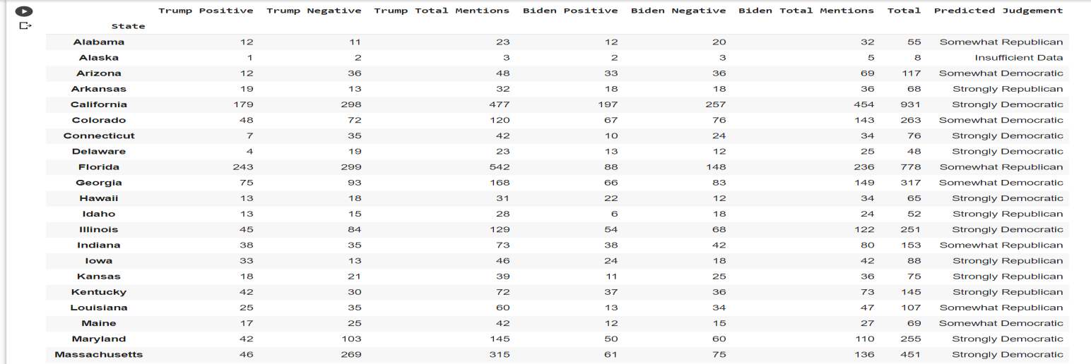
Predicted Results

Slide 31
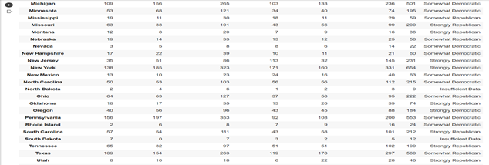
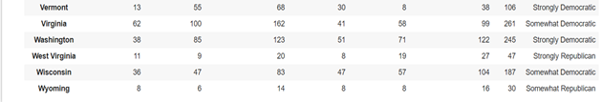
Continued...

Slide 32
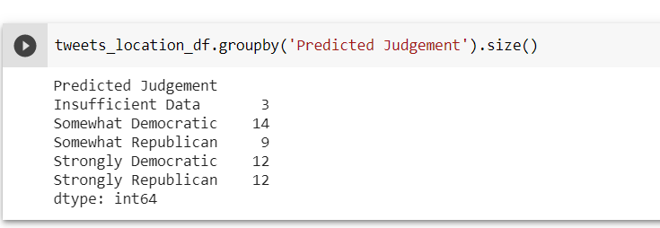
Predicted Results

Slide 33
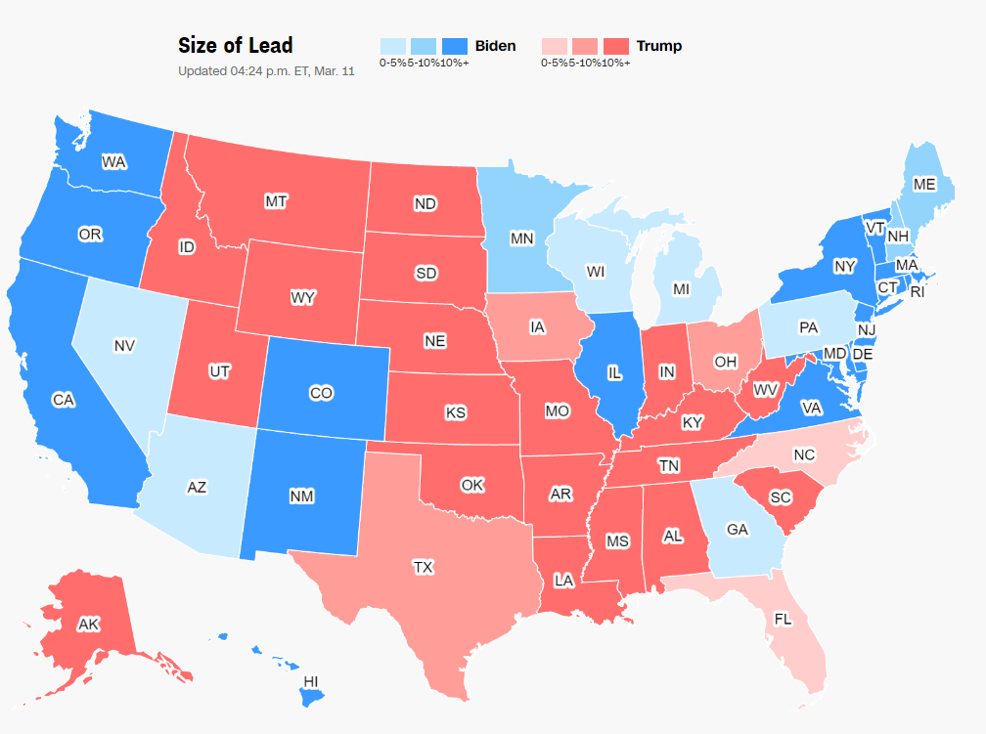
Actual Results

Slide 34
Comparison with Actual Results
Strongly Democratic
Actual Results | Predicted Results
California, Colorado, Connecticut, Delaware, Hawaii, Illinois, Maryland, Massachusetts, Minnesota, New Hampshire, New Jersey, New Mexico, New York, Oregon, Rhode Island, Virginia, Vermont, Washington | California, Connecticut, Delaware, Hawaii, Illinois, Maryland, Massachusetts, New Jersey, New Mexico, New York, Oregon, Vermont, Washington
Somewhat Democratic
Actual Results | Predicted Results
Arizona, Georgia, Maine, Michigan, Nevada, Pennsylvania, Wisconsin | Arizona, Colorado, Georgia, Maine, Michigan, Minnesota, Nevada, New Hampshire, North Carolina, Pennsylvania, Rhode Island, Virginia, Wisconsin

Slide 35
Continued...
Strongly Republic
Actual Results | Predicted Results
Alaska, Arkansas, Idaho, Indiana, Kansas, Kentucky, Missouri, Montana, Montana, Nebraska, North Dakota, Oklahoma, South Carolina, South Dakota, Tennessee, Utah, West Virginia | Arkansas, Arkansas, Idaho, Kansas, Kentucky, Missouri, Montana, Montana, Oklahoma, South Carolina, Tennessee, Utah, West Virginia
Somewhat Republic
Actual Results | Predicted Results
Florida, Iowa, North Calorina, Ohio, Texas, Wyoming | Alabama, Florida, Iowa, Nebraska, Ohio, Texas, Wyoming

Slide 36
Conclusion
The objective to analyse twitter information on a 2020 USA elections with the help on user tweets the same topic is successfully completed. Various libraries like numpy, matplotlib, nltk and pandas are moreover utilized for easier examination and visualization of the results obtained.
In this project we compared the results of four supervised classification algorithms. We inferred that Logistic Regression Algorithm was well performing among the four on our dataset. Tweets were accurately classified into positive and negative and filtered according to its subject and location.
Public opinion was predicted for the USA 2020 presidential elections for each state and it was inferred that the democratic party has greater chance of winning than the Republic party. The democratic party is leading in the battleground states with a small margin.

Slide 37
Future Scope
• Extending the project sentiment analysis can be done on similar social-media platforms like Instagram, Facebook, Snapchat, etc can be done.
• Image Sentiment Analysis is another challenging research in this domain.
• Thirdly, dataset should have same number of tweets for all states for both candidates. But within the real world, this can be troublesome to attain in the event that not incomprehensible. Be that as it may, some distribution models should be included for a uniform distribution of states.

Slide 38
References
1.Prakruthi V, Sindhu D and Dr S Anupama, “Real Time Sentiment Analysis of Twitter Posts ” In the Proceedings of 3rd International Conference on Computational Systems and Information Technology for Sustainable Solutions. (CSITSS), IEEE Explore, December 2018.
2. Agarwal, B. Xie, I. Vovsha, O. Rambow, R. Passonneau, “Sentiment Analysis of Twitter Data", In Proceedings of the ACL 2011Workshop on Languages in Social Media,2011 , pp. 30-38
3.Po-Wei Liang, Bi-Ru Dai,”Opinion Mining on Social Media Data”, IEEE 14th International Conference on Mobile Data Management Milan, Italy, June 3-6, 2013, ISBN:978-494673-6068-5.
4.Pablo Gamallo, Marcos Garcia, “Citius: A Naïve Bayes Strategy for Sentiment Analysis on English Tweets”,8th International Workshop on Semantic Evaluation, Dublin, August 2014.
5.R Xia, C Zong and S Li, “Ensemble of feature sets and classification algorithms for Sentiment Classification”, Information Sciences: an International Journal, Vol. 181.

Slide 39
6. Go, R Bhayani, L huang, “Twitter Sentiment Classification Using Distant Supervision”, Stanford University, Technical Paper 2009.
7. Dmitry Davidov, Ari Rappoport , “Enhanced Sentiment Learning Using Twitter Hashtags and Smileys”, Coling 2010: Poster VolumePages 241, August 2010.
8. Bifet and E Frank, “Sentiment Knowledge Discovery in Twitter Streaming Data”, In Proceedings of the 13th International Conference on Discovery Science, Berlin, Germany: Springer 2010.
9. Zhao Jianqiang and Gui Xiaolin,”Comparison Research on Text Pre Processing Methods on Twitter Sentiment Analysis” , In IEEE Research Journal., 22 February 2017, DOI: 1109/ACCESS.2017.2672677.
10. Rasika Wagh and Payal Punde, “Survey on Sentiment Analysis using Twitter Dataset”, In Proceedings of 2018 Second International Conference on Electronics, Communication and Aerospace Technology (ICECA), IEEE, October 2018.
11. P. D. Turney, “Thumbs up or thumbs down ?: semantic orientation applied to unsupervised classification of reviews,” In Proceedings of the 40th Annual Meeting on Association for Computational Linguistics, 2002.

Slide 40
12. A Pak and P. Paaroubek, “Twitter as a Corpus for Sentiment Analysis and Opinion Mining”, In Proceedings of the Seventh Conference on International Language Resources and Evaluation, 2010.
13. R Parikh and M Movassate, “Sentiment Analysis of User Generated Twitter Updates using Various Classification Techniques” CS224N Final Report, 2009.
14. Lokesh Mandloi and Ruchi Patel, “Twitter Sentiment Analysis using Machine LearningMethods”, In Proceedings of2020International Conference for Emerging Technology (INCET), IEEE, August 2020.
15.https://scikitlearn.org/stable/modules/generated/sklearn.tree.DecisionTreeClassifier.ht ml.
16.https://scikitlearn.org/stable/modules/generated/sklearn.neighbors.KNeighborsClassifi er.html
17.https://scikitlearn.org/stable/modules/generated/sklearn.ensemble.RandomForestClassi fier.html
18.https://scikitlearn.org/stable/modules/generated/sklearn.linear_model.LogisticRegressi on.html
19.https://www.tutorialspoint.com/python_text_processing/python_tokenization.html
20.https://www.tutorialspoint.com/python_data_science/python_stemming_and_lemmatiz ation.html

Slide 41
Thank You

